Slide 1
Design & Applications of Optimal Decision Making Models
最佳化決策模式設計與應用
Day 5
王 逸 琳 I-Lin Wang
ilinwang@mail.ncku.edu.tw
http://ilin.iim.ncku.edu.tw/ilin/
成功大學工業與資訊管理學系教授 2020/08/24-28 @成功校區 理學教學大樓(新大樓) 1樓36104室

Slide 2
Course Plans
Day 1: 2020/08/24 Quiz 1 [8%] (moodle or Zuvio)
Introduction (OR, applications, model/algorithm, complexity), Project Intro.
Software Installation & Demo (by TAs)
Day 2: 2020/08/25 Quiz 2 [8%], Project 1 due 08/29 11pm [15%]
Basics of Linear Programming & Integer Programming; LP modeling
Day 3: 2020/08/26 Quiz 3 [8%], Project 2 due 08/30 11pm [15%]
IP modeling techniques
Day 4: 2020/08/27 Quiz 4 [8%]
Applications: Facility Locations, Logistics Management, Routings (TSP)
Project Implementation help (by TAs)
Day 5: 2020/08/28 Quiz 5 [8%]
Applications: Routings (RPP), Scheduling (RCPSP)
Project Implementation help (by TAs)
Day 6: 2020/08/29 1-hr on-line Exam (moodle) [20%]

Slide 3
Applications
Scheduling
Cooking
Routing (Part II)
Constrained shortest path
Evacuation
TSP ➔ VRP
CPP, RPP

Slide 4
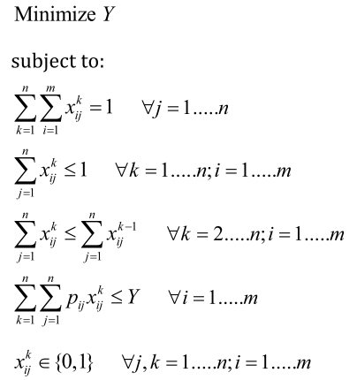
Parallel Machine Scheduling
n jobs (j) on m machines (i)
position: ordering of a job on a machine
p_{ij} : processing time of job j on machine i
Y : makespan, the latest time to complete all the jobs

Slide 5
Cooking Order Scheduling (1/2)
Indices :
i (工件、菜), i=1,…,n;
j (機台、爐子), j=1,…,m
k (機台上之 job 順序), k=1,…,u
Parameters:
Variables
客人等第i 道菜的等候時間，亦即從點菜完畢到完成出菜總共的等候時間
第i 道菜的開始烹調時刻
第j 台爐子的第 k 個順位的菜之開始烹調時刻
菜 i 於爐子 j 的第 k 順位烹調
Q: When to make which dish?
(點菜時刻)
(爐子最初開始可煮之時刻)
(菜 i 在爐子 j 需耗費的烹調時間)

Slide 6
Cooking Order Scheduling (2/2)
Objective:
Subject to.
爐子 j 的位置 k 至多處理某道菜餚 i
每道菜 i 一定會被排在某爐子 j 之某排序 k
爐子 j 之排序 k 若沒煮，則其後之排序 k+1 亦不會煮
若爐子j之排序k有煮菜i，同步化爐子j與菜i的時刻（夾擠法）
爐子j之相鄰排序時刻大小關係
客人等待菜i的總時間
設定爐子j第一個順位可開始烹調的時刻

Slide 7
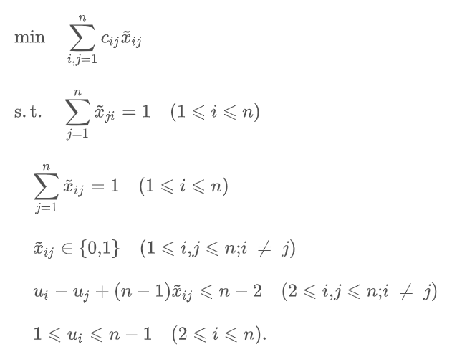
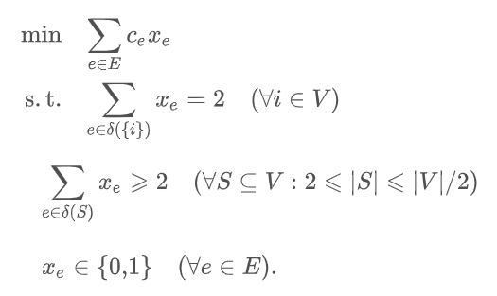
Traveling Salesman Problem
Given n nodes, cij as distance from node i to node j
How to visit all nodes (each one exactly once) with minimum total travel cost?
MTZ formulation (Miller, 1960)
O(n2) variables
O(n2) constraints
Classical (DFJ) formulation (Dantzig, 1954)
Subtour elimination constraints are exponential in number.

Slide 8
Q & A
Thanks!
I-Lin Wang (王逸琳)
Professor
Dept of Industrial & Information Management
National Cheng Kung University http://ilin.iim.ncku.edu.tw/

